Slide 1
Banking Application Capstone Presentation
Mathias Krostewitz

Slide 2
Part 1: Front-End Architecture, Authentication, And App Diagram

Slide 3
Application Overview Diagram
FRONT END CLIENT
https://thegoodbank.azurewebsites.net/
Fetching Data between users and database
MONGODB
AZURE COSMOS
REACT APP SERVER
https://goodbank-server.azurewebsites.net

Slide 4
Part 2: Database And API

Slide 5
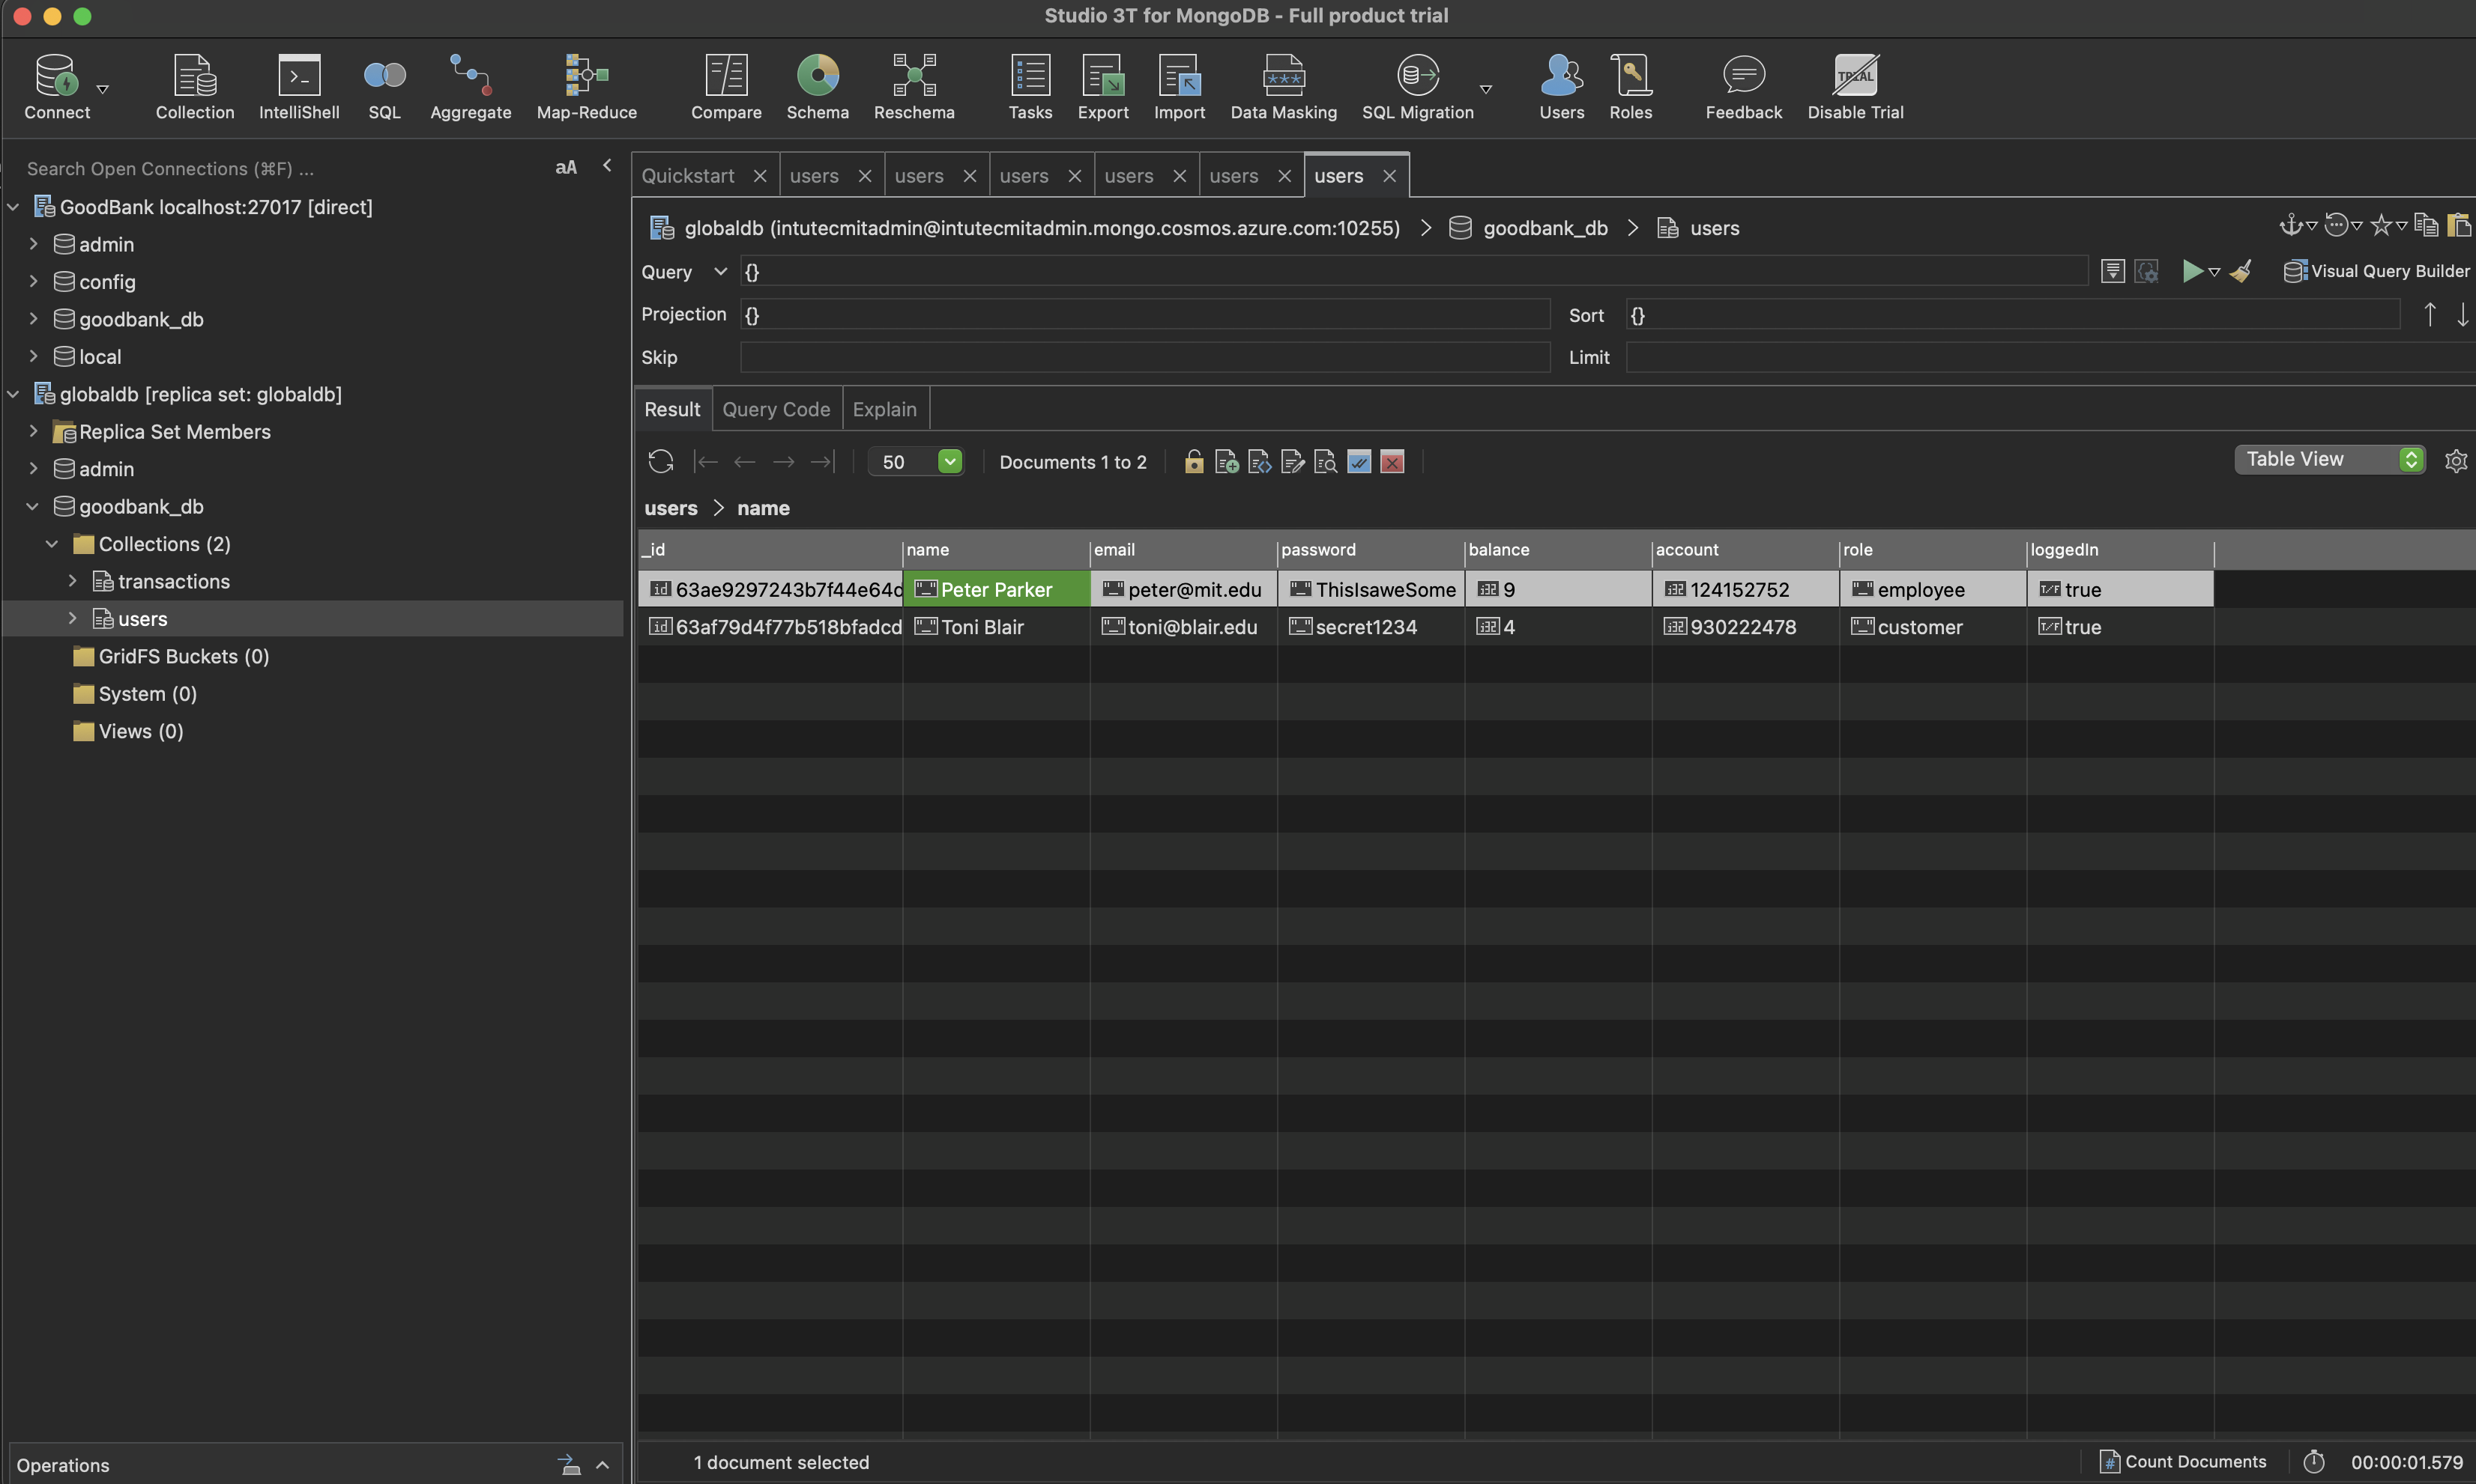
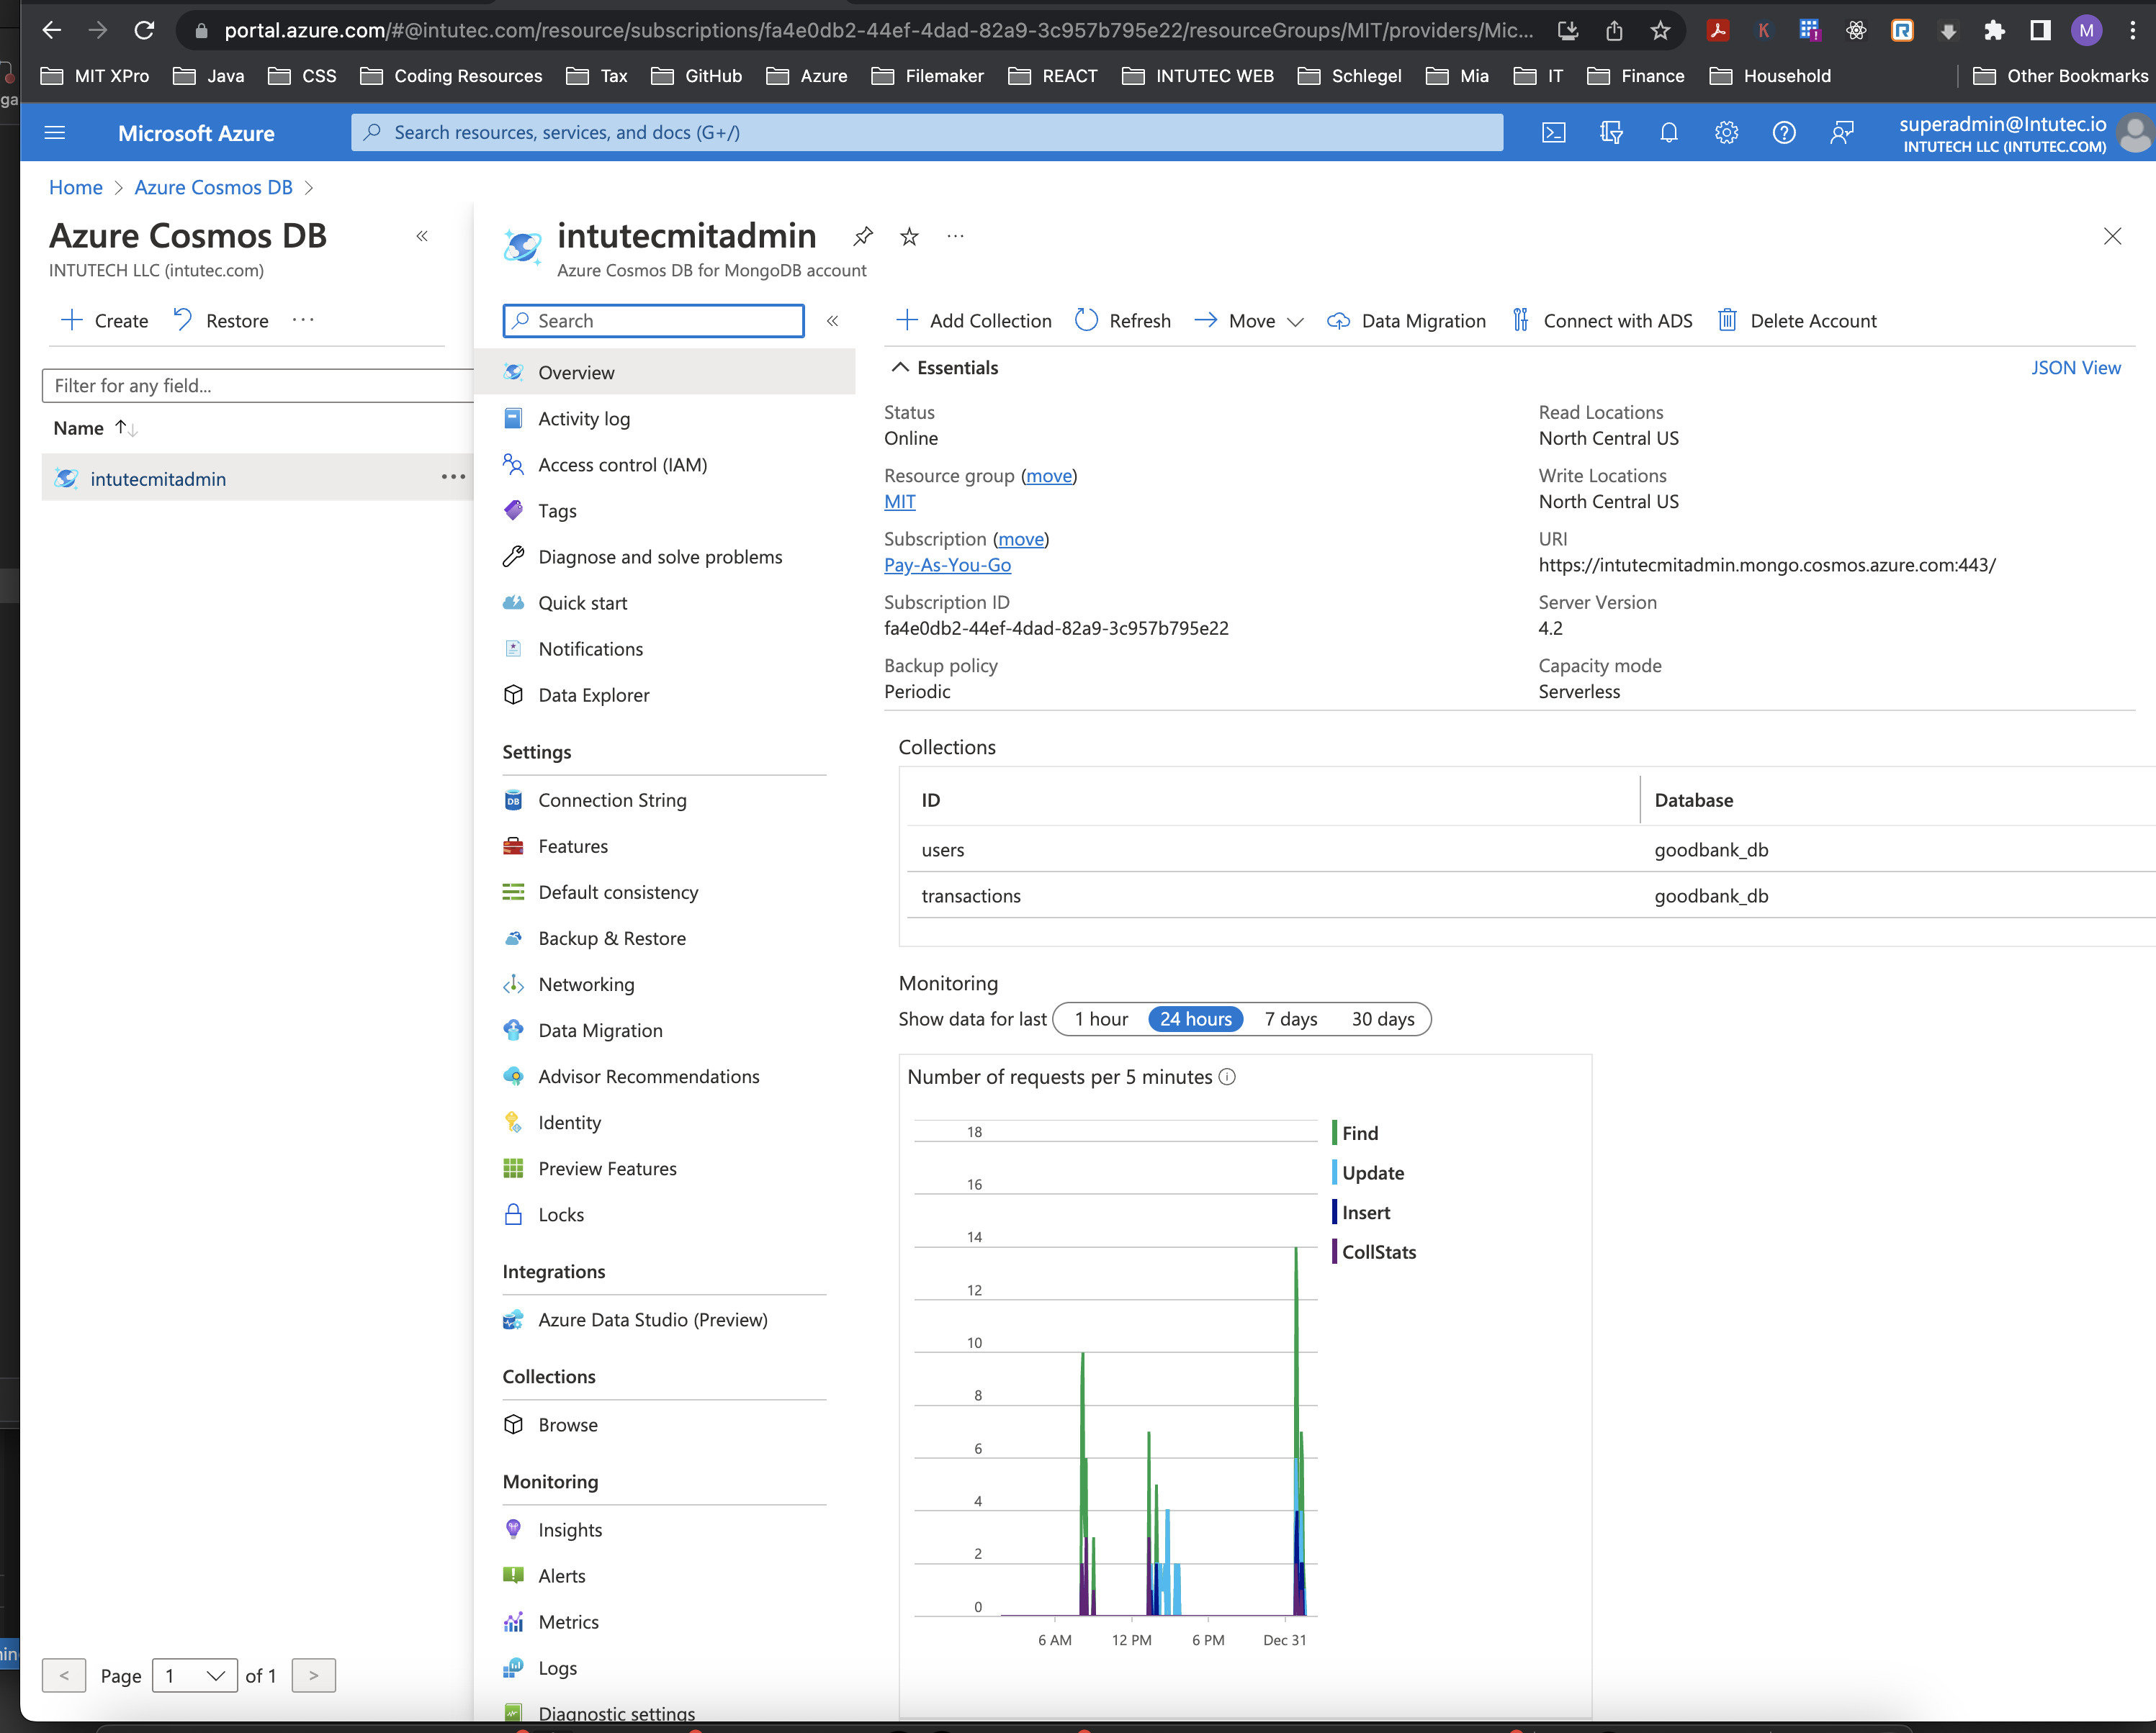
Database

Slide 6
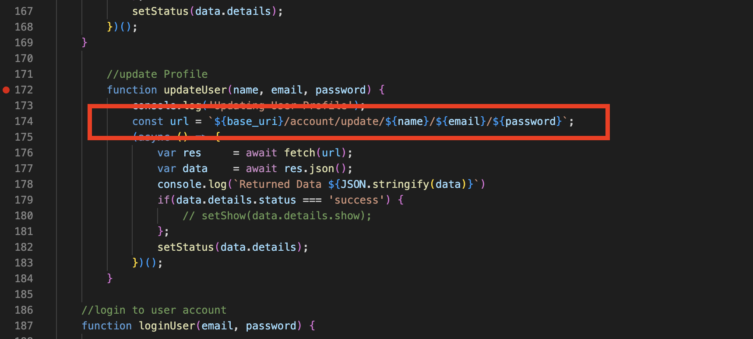
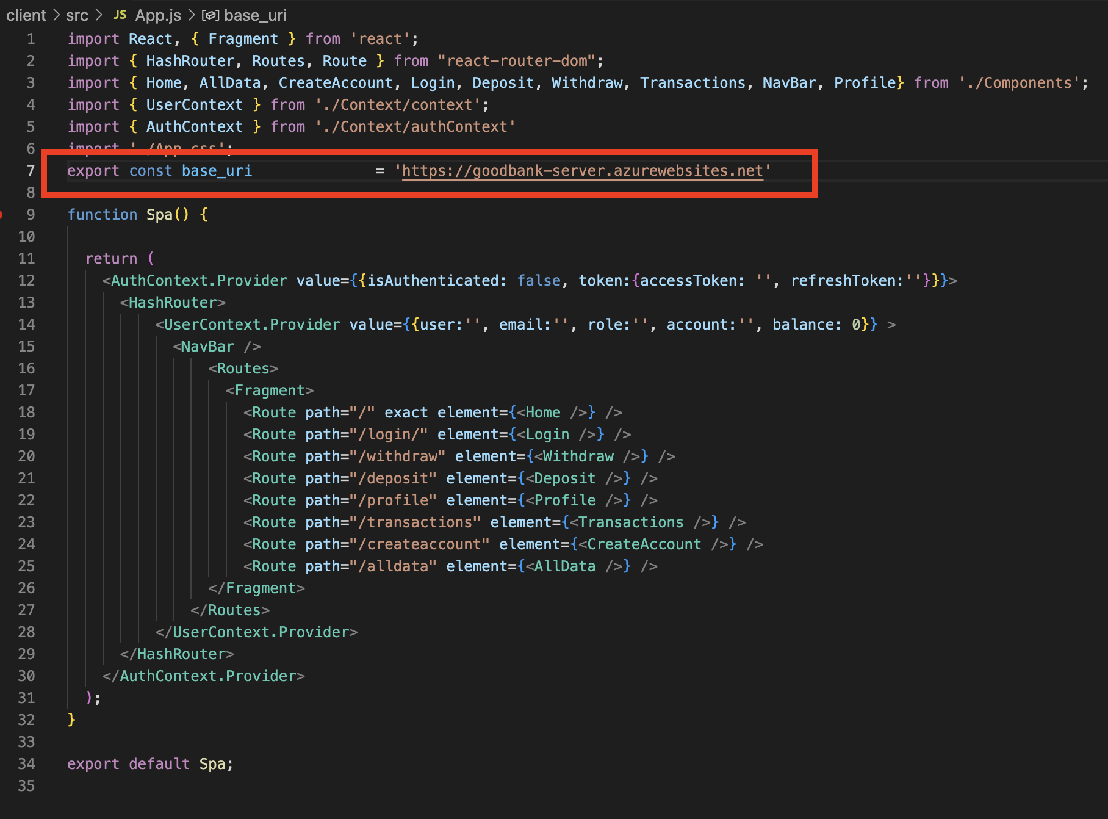
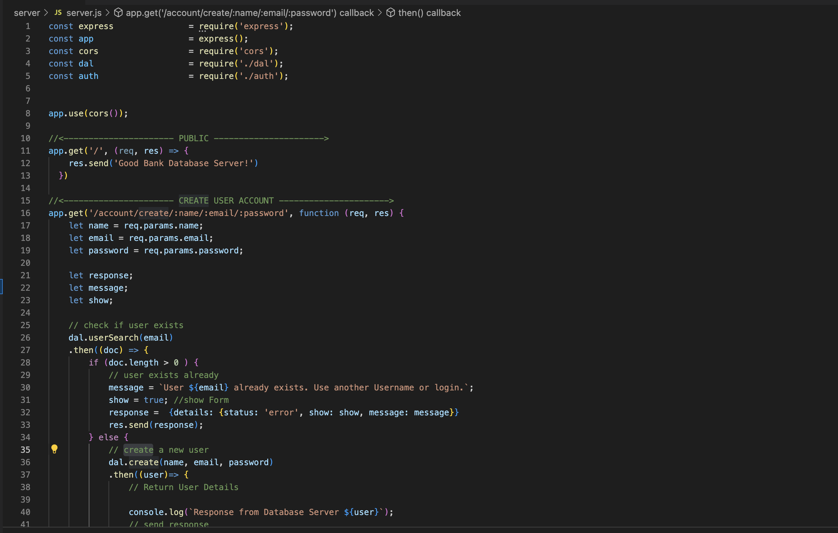
API

Slide 7
Part 3: Deployment, Additional Features, App Demonstration, Reflection

Slide 8
Deployment
Deployment
Azure Static Web App for the Client
Azure Static Web app for the node.js server
Azure cosmos db for the database storage
Additional Features
Profile Update Capabilities after successful login
Automatically generating Account numbers
Every User (email) can only register once
Every Transaction is recorded
Reflection
- I have spent way too much time on the navigation issue. While I should have moved on and completed the rest, I decided to go all for it – which wasted time. As the end I followed the advice given in the course and moved on and got the right idea later
I still struggle to find a secure and proper way to save sensible user data as cookie or in local storage.

Slide 9
Additional Features
Additional Features
Profile Update Capabilities after successful login
Automatically generating Account numbers
Every User (email) can only register once
Every Transaction is recorded

Slide 10
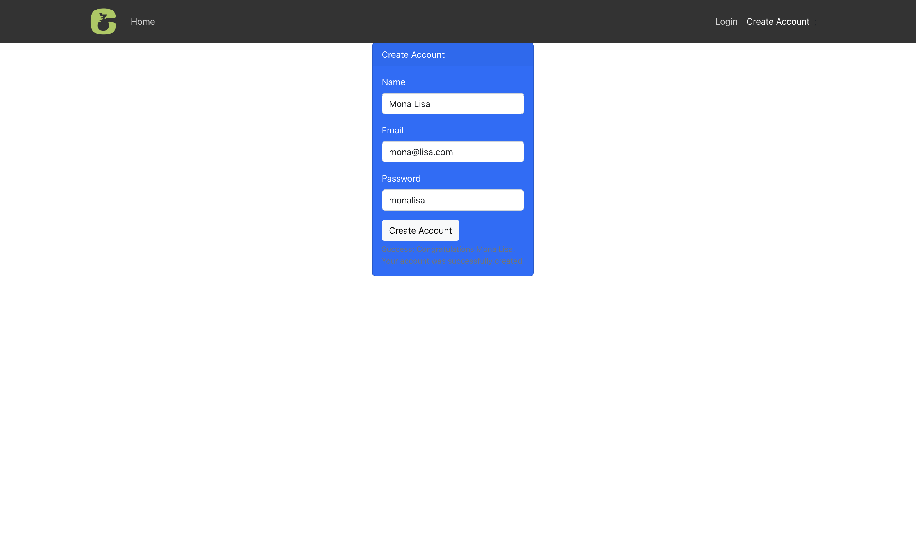
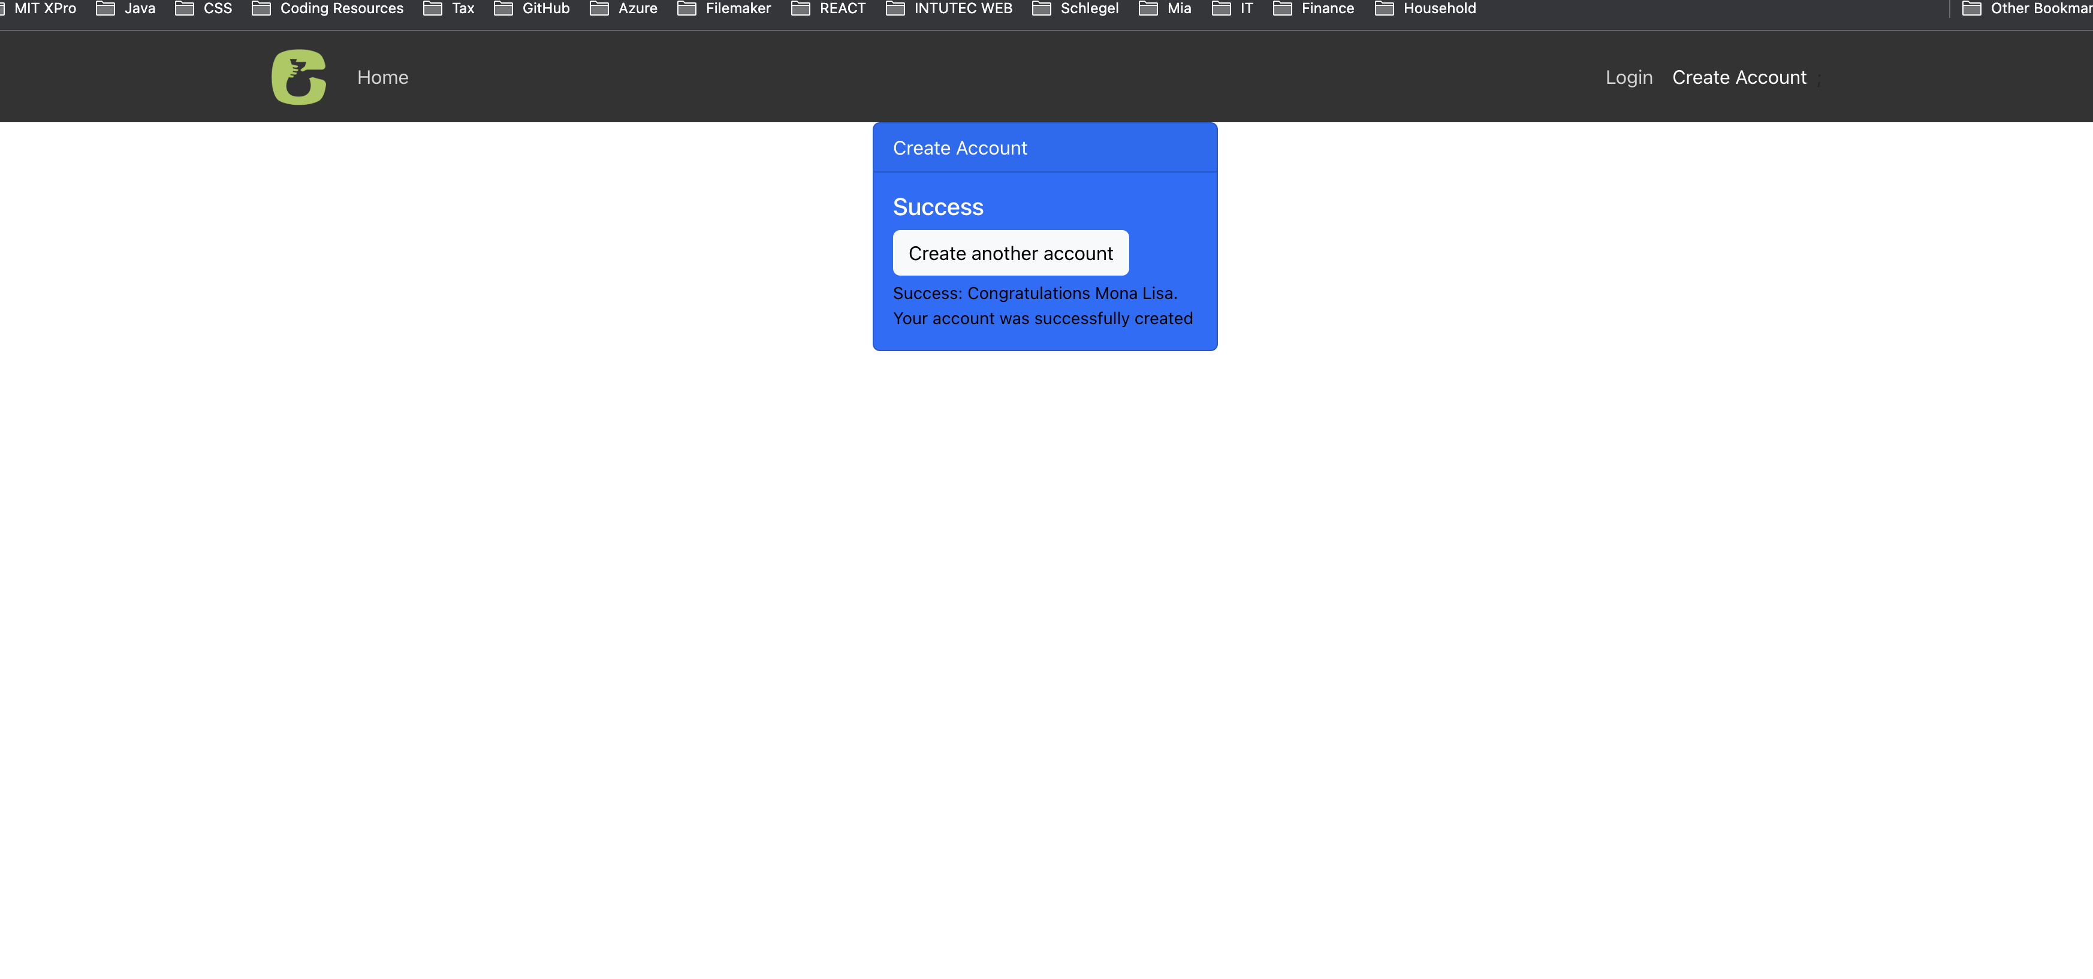
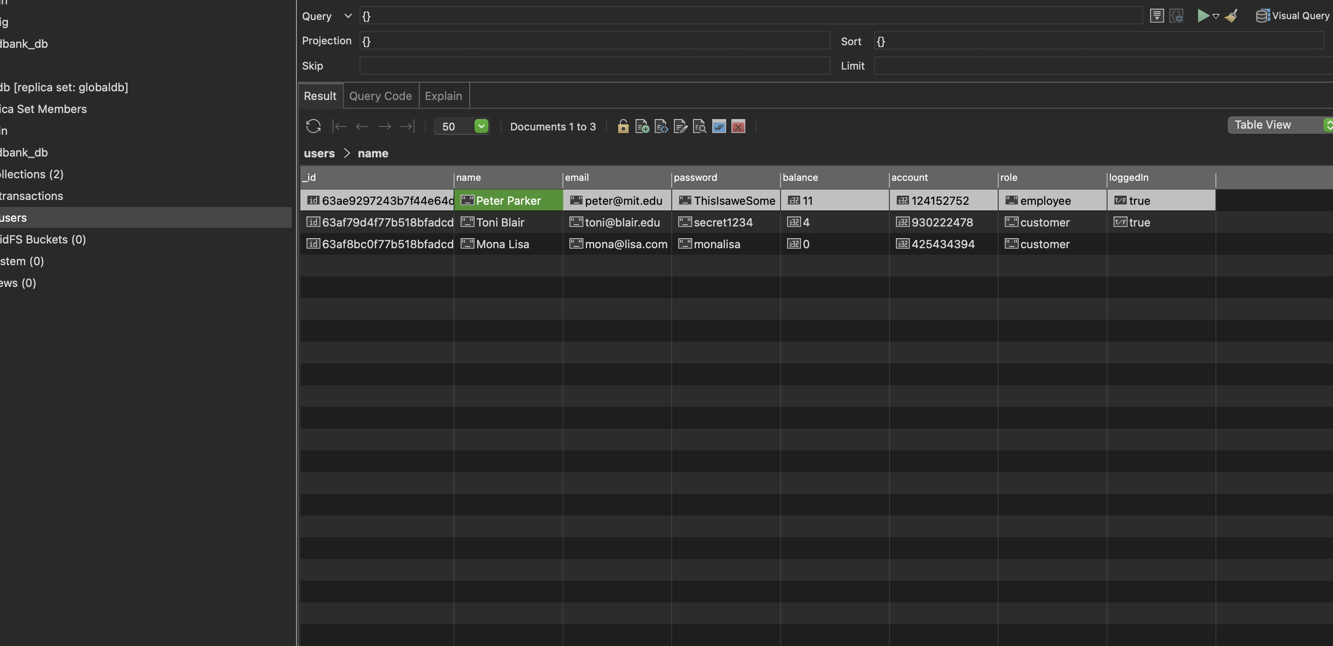
Application Demonstration – Create Account, Log In, Deposit, Withdraw
CREATE ACCOUNT

Slide 11
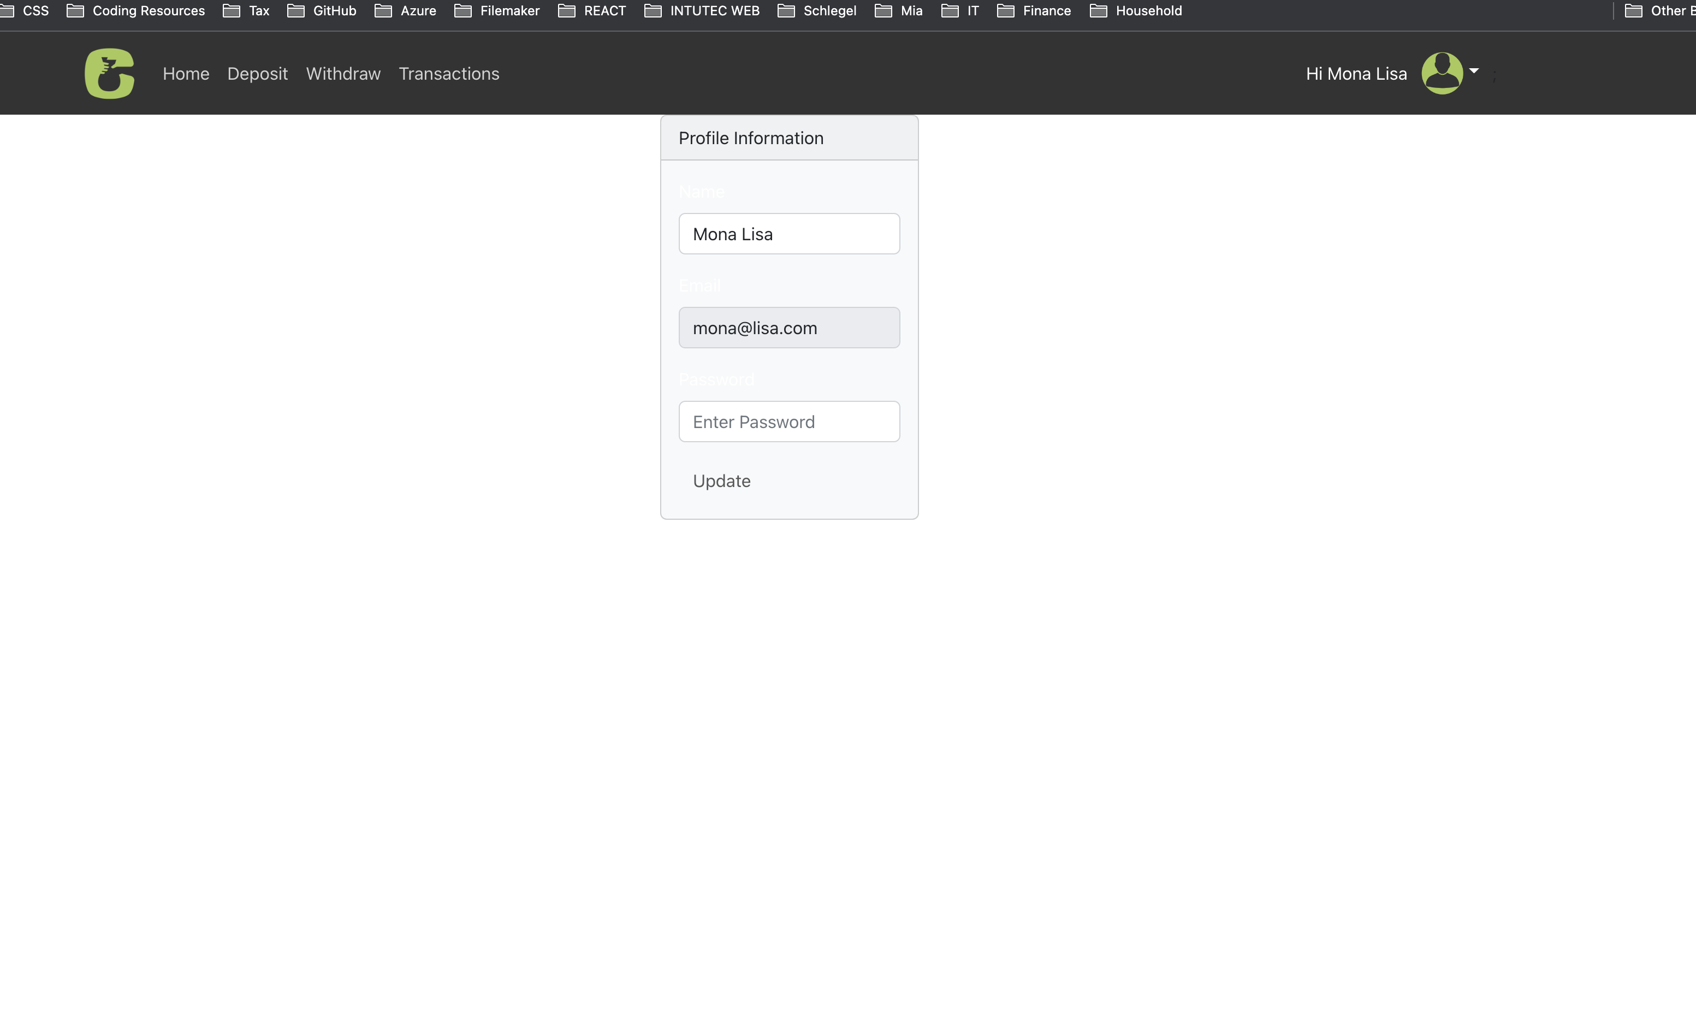
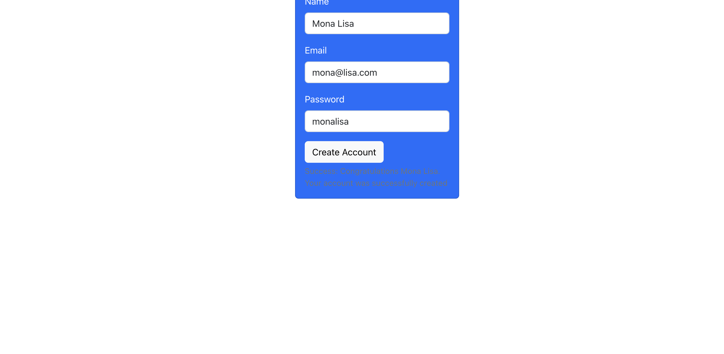
Application Demonstration – Create Account, Log In, Deposit, Withdraw
LOGIN

Slide 12
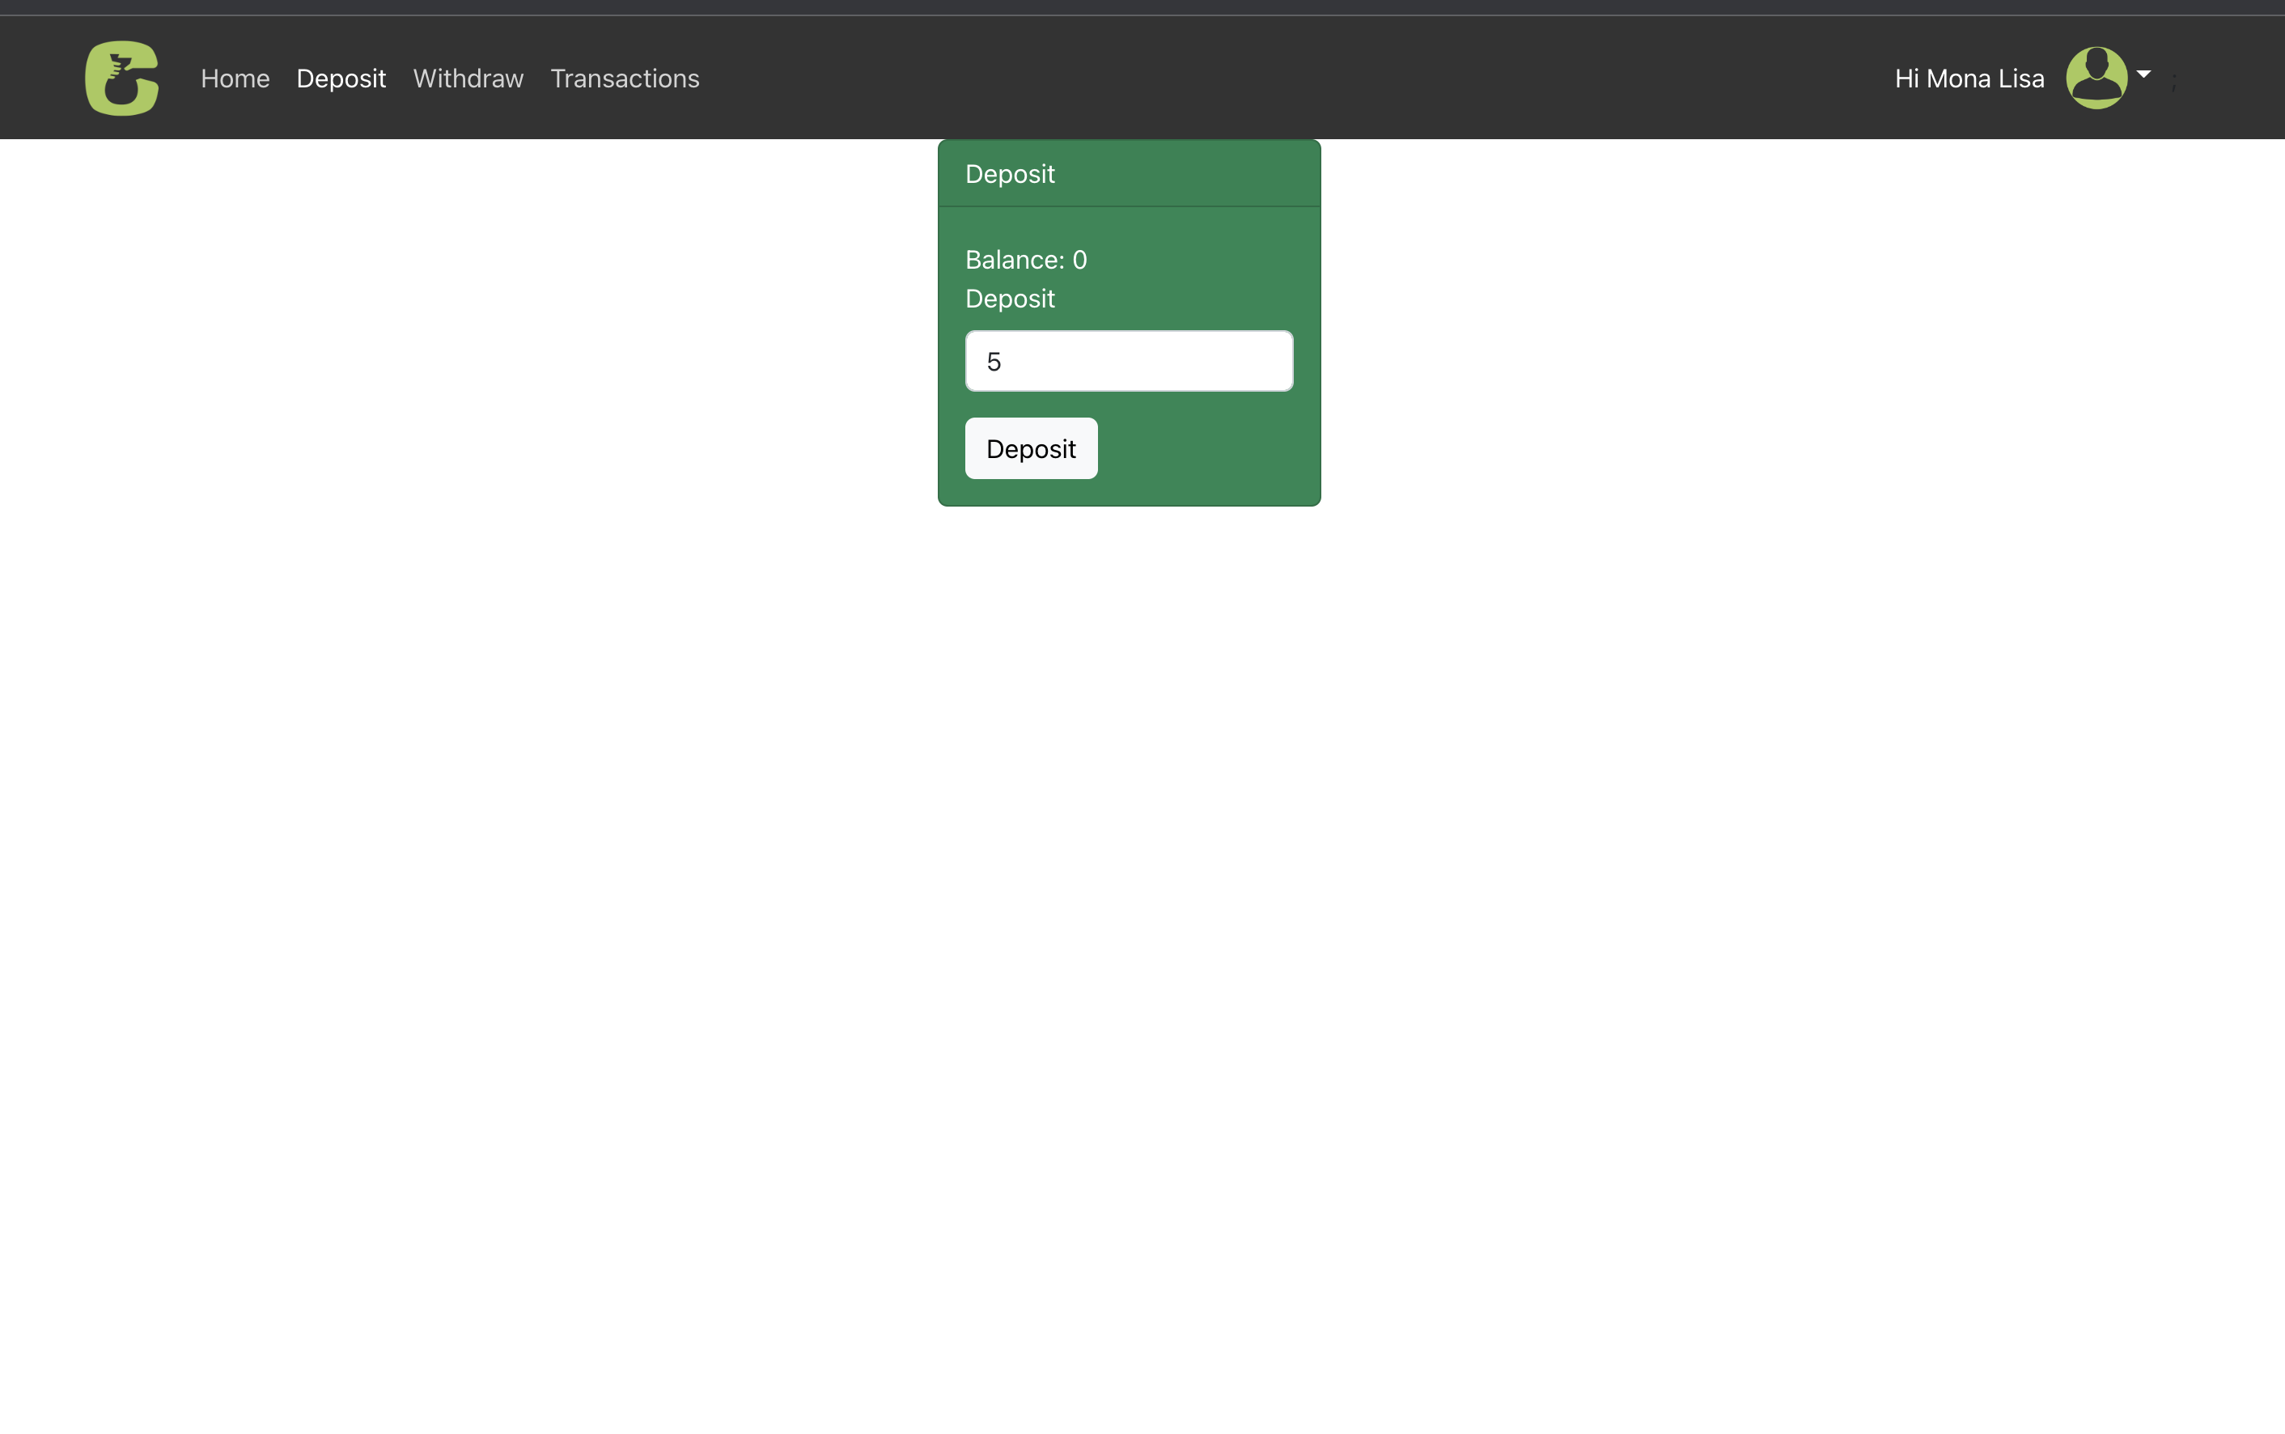
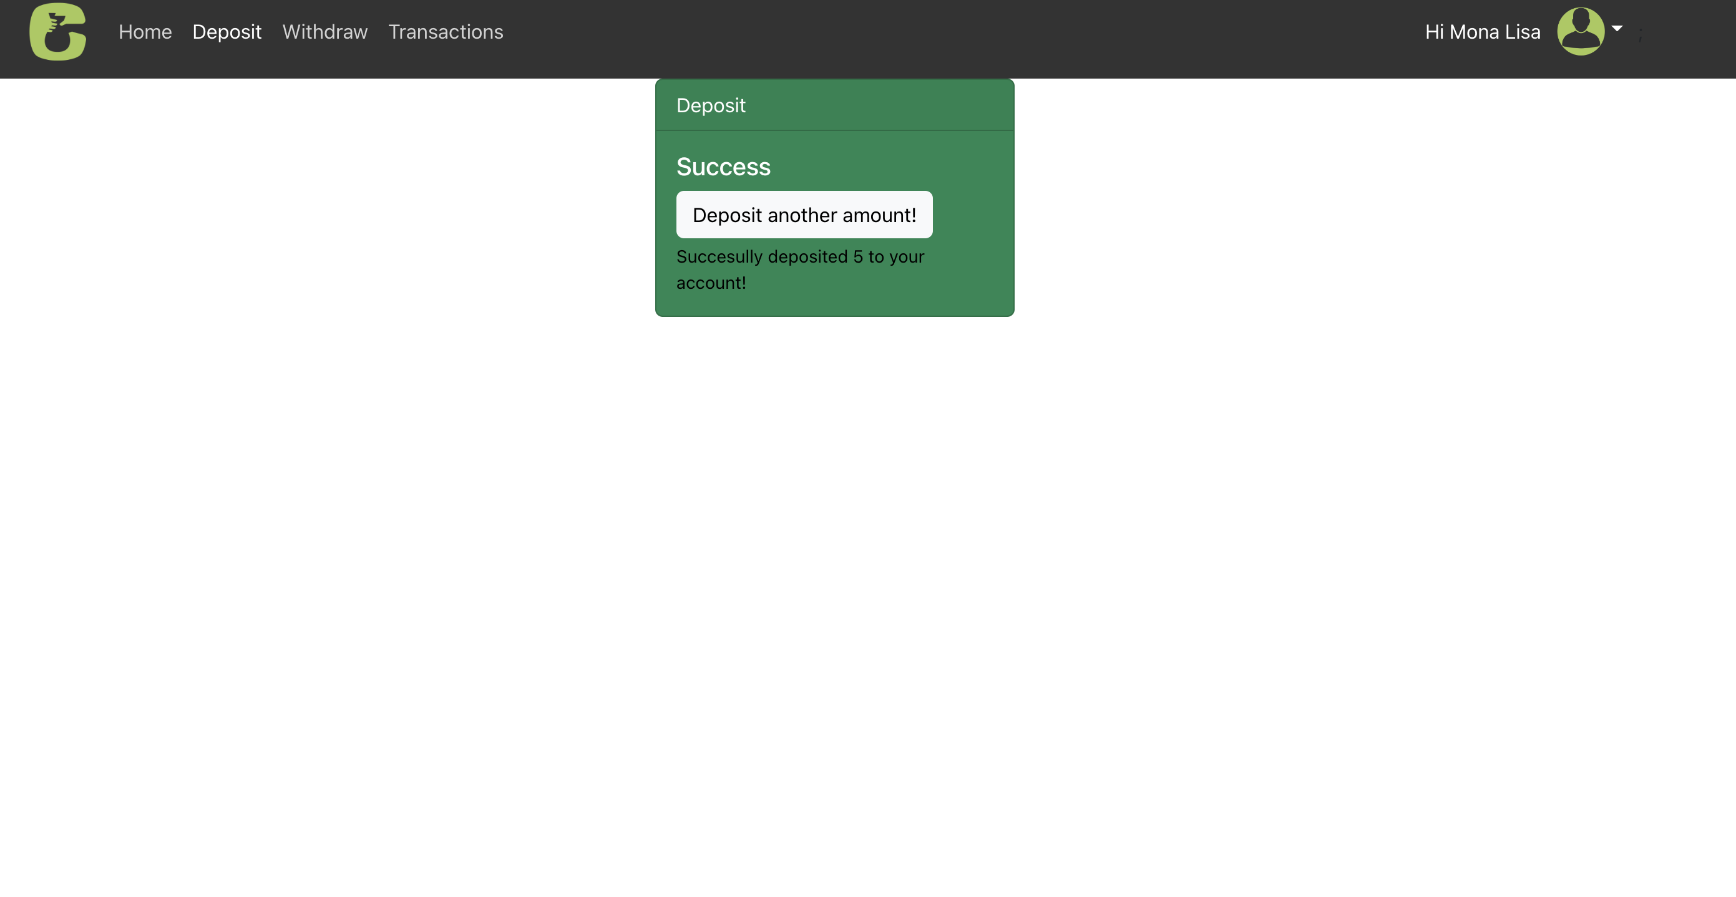
Application Demonstration – Create Account, Log In, Deposit, Withdraw
DEPOSIT

Slide 13
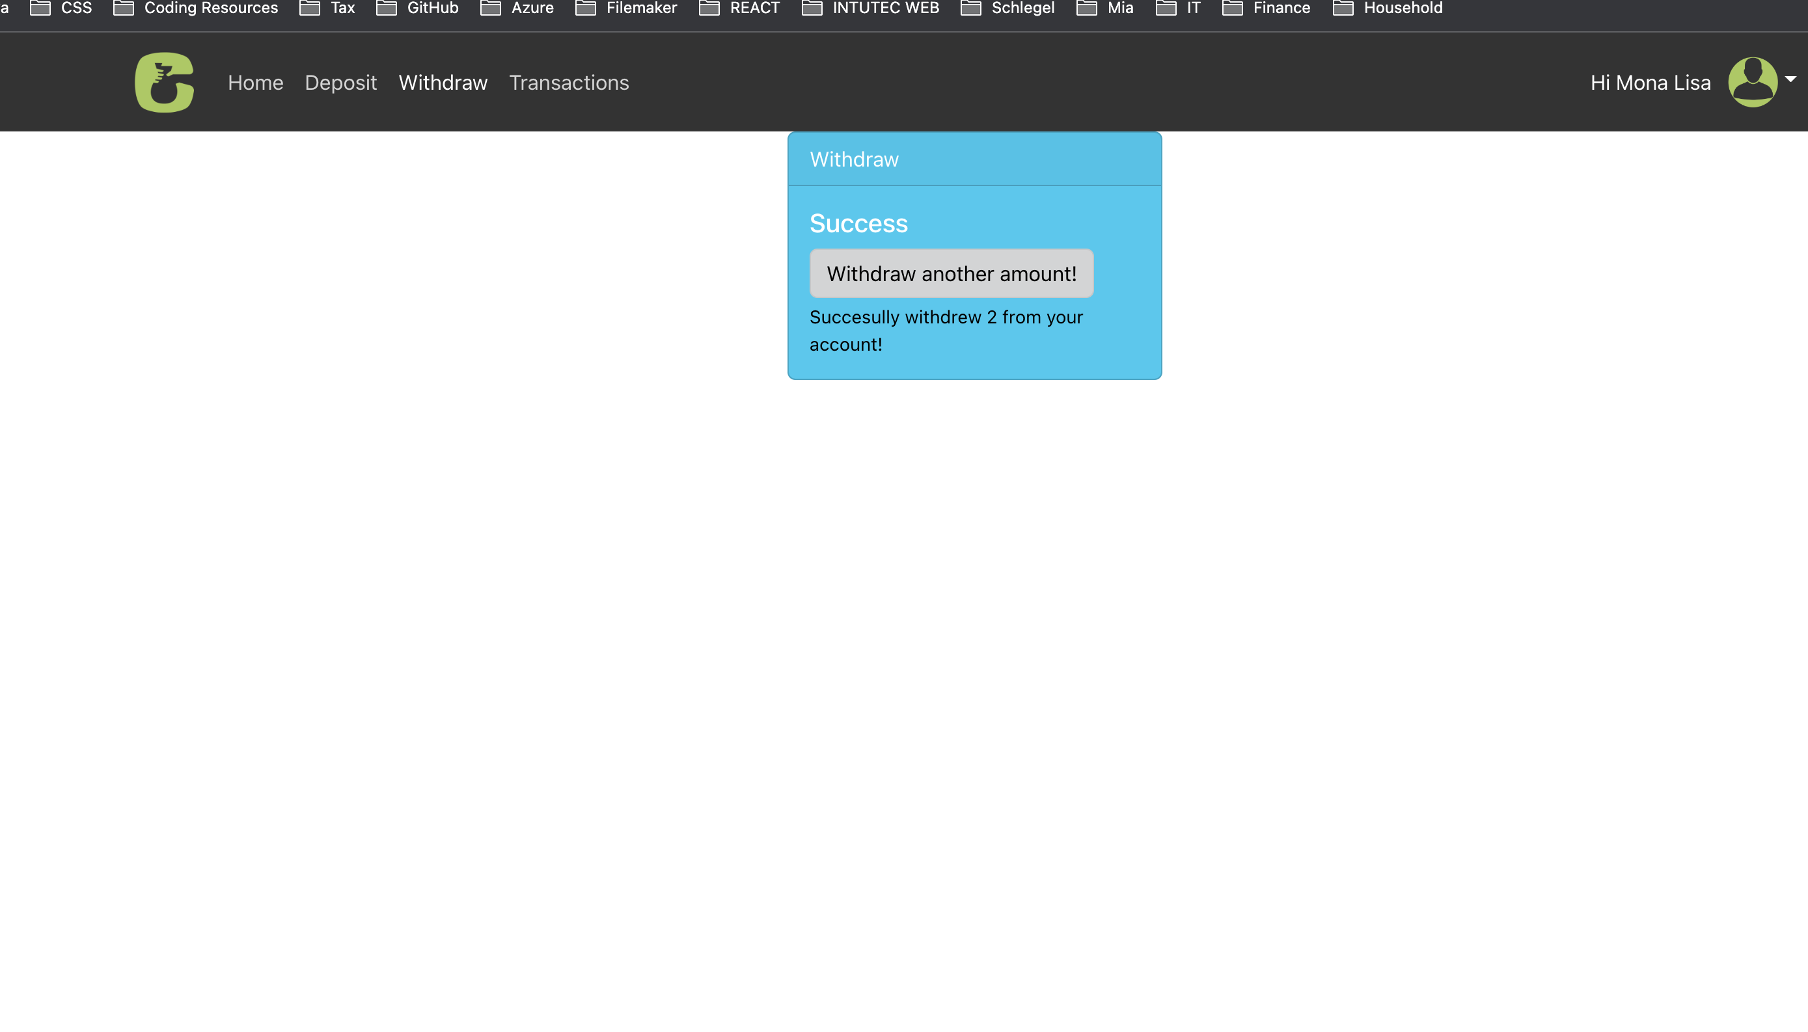
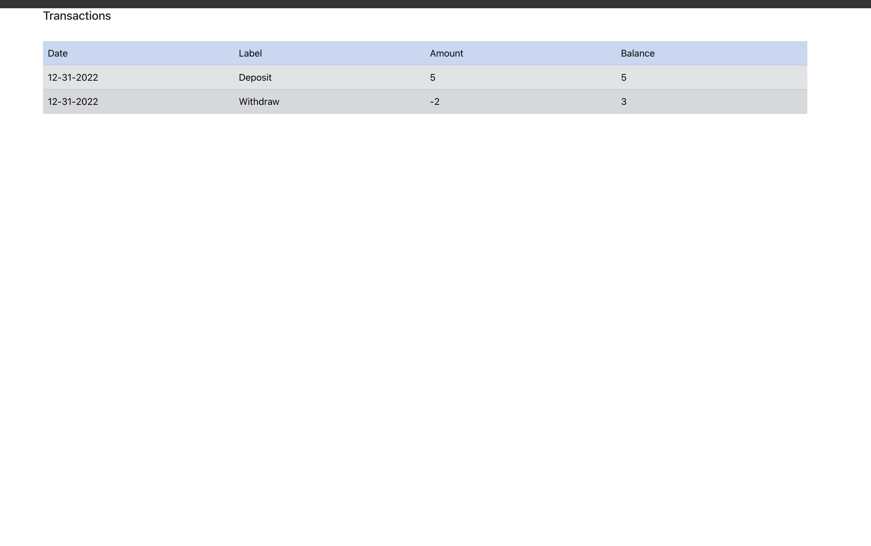
Application Demonstration – Create Account, Log In, Deposit, Withdraw
WITHDRAW

Slide 14
Reflection
Reflection
- I have spent way too much time on the navigation issue. While I should have moved on and completed the rest, I decided to go all for it – which wasted time. As the end I followed the advice given in the course and moved on and got the right idea later
I still struggle to find a secure and proper way to save sensible user data as cookie or in local storage.

